Slide 1

Chi-square Model on Shoe Categories
Leticia Lugo
MS Data Analytics
WGU

Slide 2
Zappos.com
The analysis aims to compare the relationship between leather shoes and sales on the Zappos.com website.
Null Hypothesis:
There is no significant difference between the material and the shoe category.

Slide 3
Dataset
The dataset consists of nine categorical variables.
The dataset for the study is limited by using only two variables: shoes material and shoes categories.
Also it is limited by not using the shoe pictures.
This dataset is limited by the accuracy and completeness of online shoppers
(UT Zappos50K, n.d.).

Slide 4
Chi-square Advantages
Can test the association between variables.
Identifies differences between observed and expected values.
Can make no assumptions about the distribution of the population
(When Chi-square Is Appropriate, n.d.).

Slide 5
Chi-square Disadvantages
The data must be converted to numerical variables.
The test becomes invalid if any expected values are below five.
All participants measured must be independent
(When Chi-square Is Appropriate, n.d.).

Slide 6
Challenges of the Analysis
Converting the categorical variables to numerical variables of each shoe category.
Extracting the word “leather” in the material variable and storing in a new variable “MT”.
Assigning a value to the new variable: “leather = 1” and “No-leather = 0”.

Slide 7
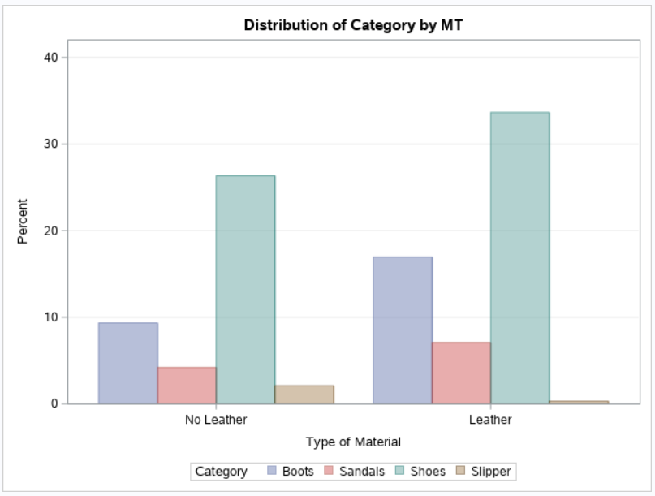
A Frequency Plot

Slide 8
Chi-Square Results
The results show that shoes manufactured with leather are 64.51% of “Boots” vs. 56.12% of “Shoes”.
The results show that shoes manufactured with leather are 12.54% of “Slipper” vs. 56.12% of “Shoes”.
(Chi-square, n.d).

Slide 9
Suggestions for Future Research
Analyze with different manufacturer materials based on the needs of the company.
Use different methods to accommodate the rest of the variables.
Use the shoe images to create a model.
Use Logistic regression analysis to find the probabilities of a material or shoe description would be preferred.

Slide 10
Conclusion
The findings of this study provide a way to determine which shoe item is manufactured with leather and its selling percentage. As a result, the company can cut costs, find the most valuable materials, find the less used materials, or find less expensive material substitutes for leather shoes that do not sell well.

Slide 11
Zappos.com
References:
SAS - Chi Square - Tutorialspoint. (n.d.). Www.tutorialspoint.com. Retrieved July 29, 2021, from https://www.tutorialspoint.com/sas/sas_chi_square.htm
UT Zappos50K. (n.d.). Vision.cs.utexas.edu. Retrieved July 22, 2021, from http://vision.cs.utexas.edu/projects/finegrained/utzap50k
When Chi-square Is Appropriate - Strengths/Weaknesses | Chi-square Test for Goodness of Fit in a Plant Breeding Example - passel. (n.d.).
Passel2.Unl.edu. https://passel2.unl.edu/view/lesson/9beaa382bf7e/14

